Slide 1

Git and GitHub
www.cognixia.com

Slide 2

Git and GitHub
+91 898-002-4735 (973) 598-3969 44 203-808-4216 +973 1619-8549
www.cognixia.com

Slide 3


Introduction
Motivation
Saving files over and over with different suffixes to have access to previous versions
Emailing files back and forth to work with one other person
+91 898-002-4735 (973) 598-3969 44 203-808-4216 +973 1619-8549
www.cognixia.com

Slide 4
What is Version Control System?
A system that keeps records of your changes
Allows for collaborative development
Allows you to know who made what changes and when
Allows you to revert any changes and go back to a previous state
+91 898-002-4735 (973) 598-3969 44 203-808-4216 +973 1619-8549
www.cognixia.com

Slide 5
Introduction: Git vs GitHub
Version control and Collaboration
Git: Distributed Version Control System
all changes done to a "repository" (folder) are saved by Git
has its own file structure under the hood
historical hash to content key is saved for each snapshot
can be used locally without internet to do version control
+91 898-002-4735 (973) 598-3969 44 203-808-4216 +973 1619-8549
www.cognixia.com

Slide 6
What is Version Control System?
git
Popular Version Control System
SVN
Clearcase
Mercury
+91 898-002-4735 (973) 598-3969 44 203-808-4216 +973 1619-8549
www.cognixia.com

Slide 7
What is Git?
Created by Author of Linux, Linus Torvald
Distributed version control
Users keep entire code and history on their location machines
Users can make changes without internet access
(Cannot push or pull from a remote changes from a remote server)
+91 898-002-4735 (973) 598-3969 44 203-808-4216 +973 1619-8549
www.cognixia.com

Slide 8
Introduction: Git vs. Github
Version control and Collaboration
Why is it called a "distributed version control system"?
Leads to GitHub...
GitHub: Repository Hosting Service
can host the tracked repository (folder)
if you delete it locally, will still be hosted online
many people can download and share the same repository, work on the stored code as a team
+91 898-002-4735 (973) 598-3969 44 203-808-4216 +973 1619-8549
www.cognixia.com

Slide 9


What is GitHub?
Is a Cloud Provider for git services
Other vendors such as: BitBucket, Gitorious, etc.
+91 898-002-4735 (973) 598-3969 44 203-808-4216 +973 1619-8549
www.cognixia.com

Slide 10
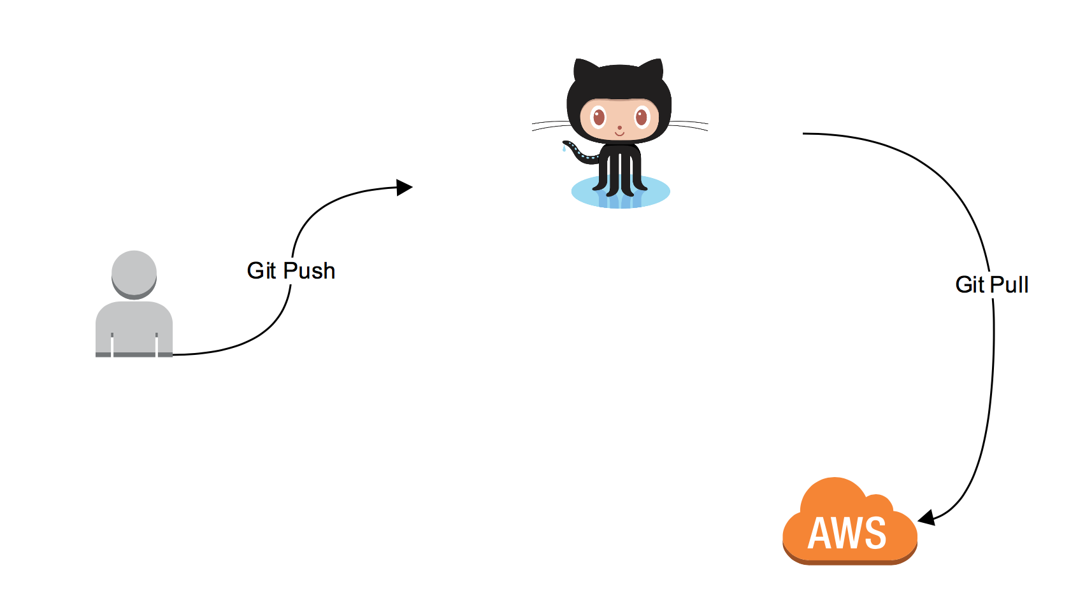
Basic Git WorkFLow (Simplified)
+91 898-002-4735 (973) 598-3969 44 203-808-4216 +973 1619-8549
www.cognixia.com

Slide 11
Installation:
Git and git bash
PS/terminal to check git version
Visual Studio Code
add code to PATH
+91 898-002-4735 (973) 598-3969 44 203-808-4216 +973 1619-8549
www.cognixia.com

Slide 12
Installation:
OS | Commands/sites
Linux (Debian) | Command: sudo apt-get install git
Linux (Redhat) | Command: sudo yum install git
Mac | http://git-scm.com/download/mac
Windows | http://git-scm.com/download/win
+91 898-002-4735 (973) 598-3969 44 203-808-4216 +973 1619-8549
www.cognixia.com

Slide 13
Basic Shell Commands
Shell commands:
- ls, ls –la
- mkdir, rm, rm –r
- cd, cd ..
- >, >>
+91 898-002-4735 (973) 598-3969 44 203-808-4216 +973 1619-8549
www.cognixia.com

Slide 14
Configuration
System: all users
Global: all repos of current user
Local: this repo only
Configure git
User and email:
git config --global user.name "Nicholas Guthrie"
" user.email "
git config --list
Should match your github name and email
git config --global –e
+91 898-002-4735 (973) 598-3969 44 203-808-4216 +973 1619-8549
www.cognixia.com

Slide 15
Git config
End of line character for windows
Text \r\n (windows)
Text \n (Linux and Mac)
If on windows: core.autocrlf = true
If on mac or linux: core.autocrlf = input
Lab: set this yourself. Check global, system and local
+91 898-002-4735 (973) 598-3969 44 203-808-4216 +973 1619-8549
www.cognixia.com

Slide 16
Git structure
Working Directory
Staging Area
Git Directory
+91 898-002-4735 (973) 598-3969 44 203-808-4216 +973 1619-8549
www.cognixia.com

Slide 17
Git Init
Command: git init
Tells git to start tracing the folder.
Creates a .git folder (hidden folder)
If this directory is gone, you lose your project history
+91 898-002-4735 (973) 598-3969 44 203-808-4216 +973 1619-8549
www.cognixia.com

Slide 18
Git Basic Commands
git status: shows working branch
git add (must be in working directory)
git commit (adds a commit object (snapshot) to the objects folder, which is a wrapped around a tree object
git log
+91 898-002-4735 (973) 598-3969 44 203-808-4216 +973 1619-8549
www.cognixia.com

Slide 19
First commit
Lab:
echo text into file
Stage file (staging area = index)
Commit file with message
(if no message, will open the editor)
Think of this as a snapshot
+91 898-002-4735 (973) 598-3969 44 203-808-4216 +973 1619-8549
www.cognixia.com

Slide 20
Git Under the Hood
Git objects:
Sha1 hash function: creates unique name from contents
- doesn't store duplicate data
Blobs: content, hashes
- no filenames (filenames are sha1 hashes)
- only one copy of each blob is saved, i.e. if the hashes match git will reuse the object!
Trees: directory structure and pointers to blobs
Commits: wrapped around tree with pointer to parents commit and meta-data
+91 898-002-4735 (973) 598-3969 44 203-808-4216 +973 1619-8549
www.cognixia.com

Slide 21
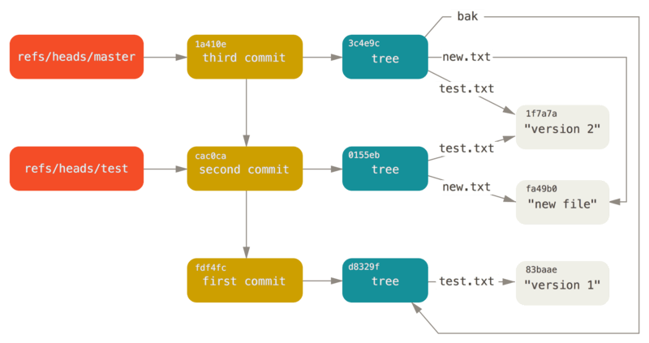
Git Commits and Tree
+91 898-002-4735 (973) 598-3969 44 203-808-4216 +973 1619-8549
www.cognixia.com

Slide 22
Low level commands
git ls-files –s : check the files in the staging area
git cat-file –p/f/s: check the contents, type or size
Lab: rm a file, but check if it's still in the staging area
Lab: open a commit message
Higher level alternative: git show
+91 898-002-4735 (973) 598-3969 44 203-808-4216 +973 1619-8549
www.cognixia.com

Slide 23
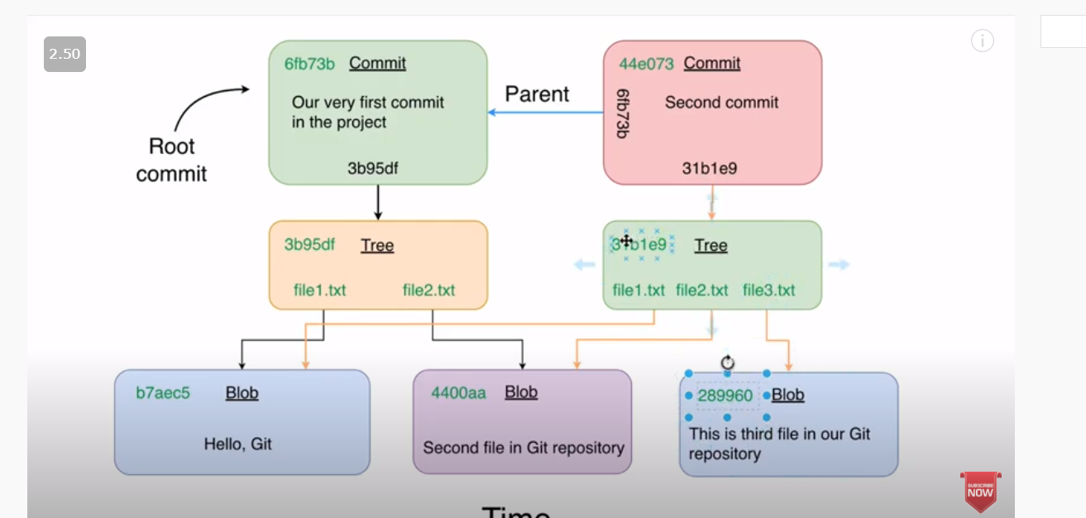
More git objects
+91 898-002-4735 (973) 598-3969 44 203-808-4216 +973 1619-8549
www.cognixia.com

Slide 24
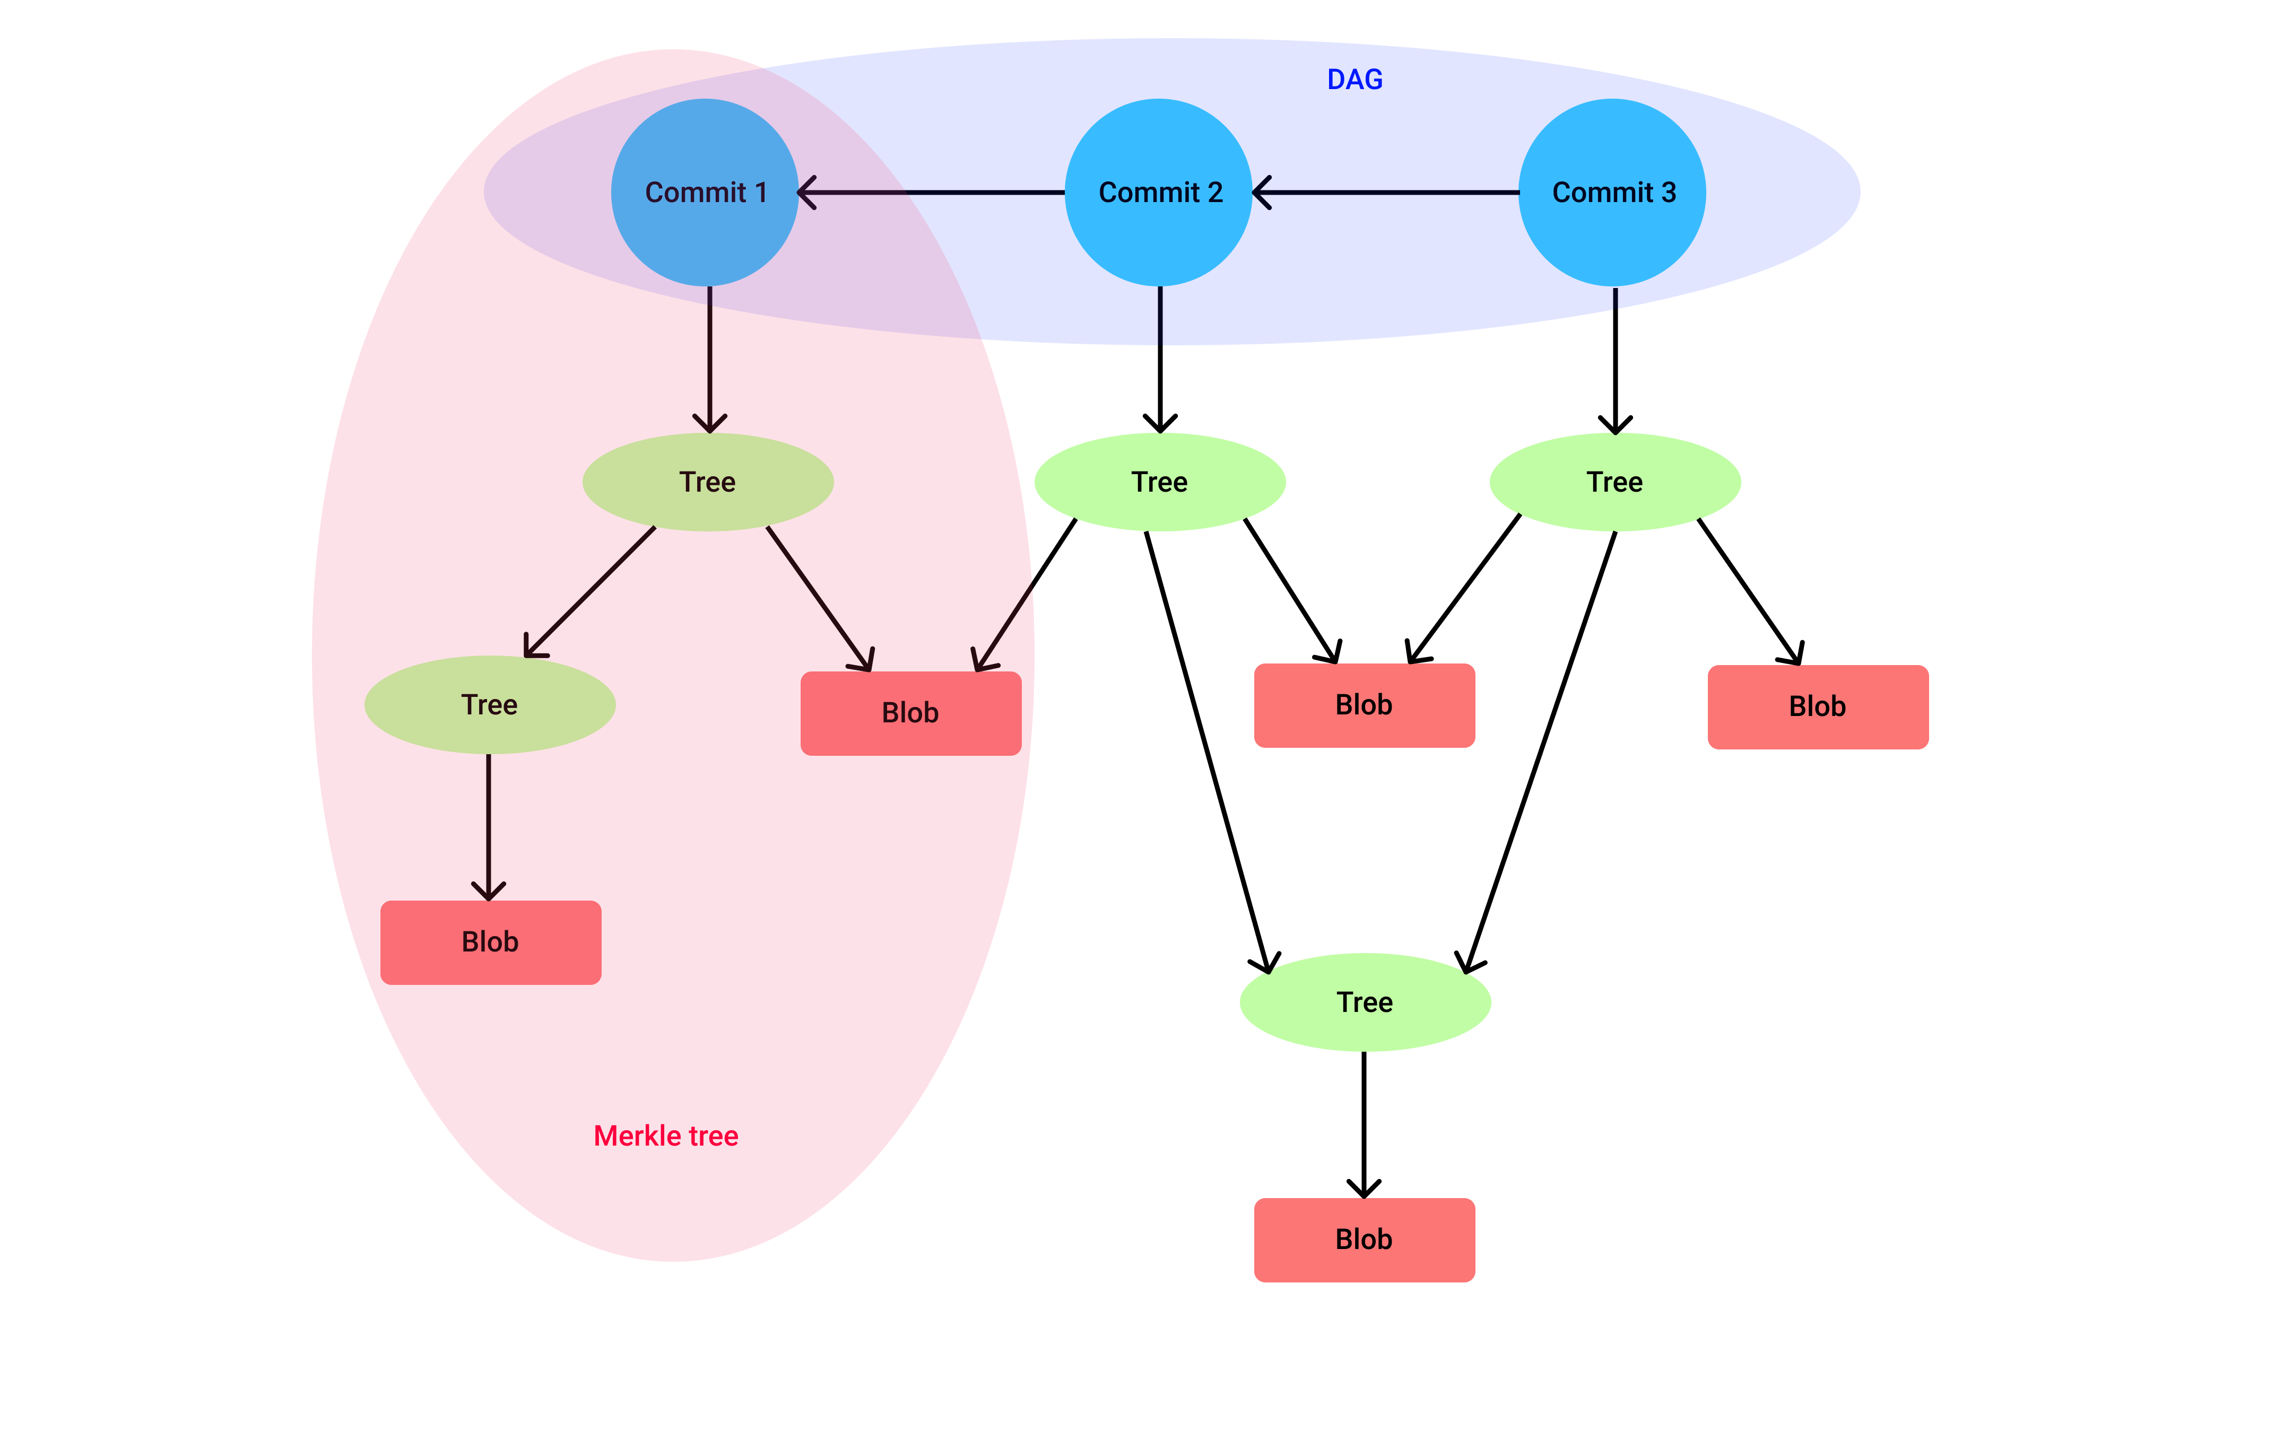
More git objects
+91 898-002-4735 (973) 598-3969 44 203-808-4216 +973 1619-8549
www.cognixia.com

Slide 25
IDE's and Git
Lab: Visual Studio Code
+91 898-002-4735 (973) 598-3969 44 203-808-4216 +973 1619-8549
www.cognixia.com

Slide 26
Git Basic Commands
git status: shows working branch
git add (must be in working directory)
git commit (adds a commit object (snapshot) to the objects folder, which is a wrapped around a tree object
git log
+91 898-002-4735 (973) 598-3969 44 203-808-4216 +973 1619-8549
www.cognixia.com

Slide 27
Git Basic Commands
Git mv <filename> <filename>
Git rm
Git rm –cached <filename>
Git diff
Git diff –staged
Note on @@ lines: git is only showing us the lines where changes take place
+91 898-002-4735 (973) 598-3969 44 203-808-4216 +973 1619-8549
www.cognixia.com

Slide 28
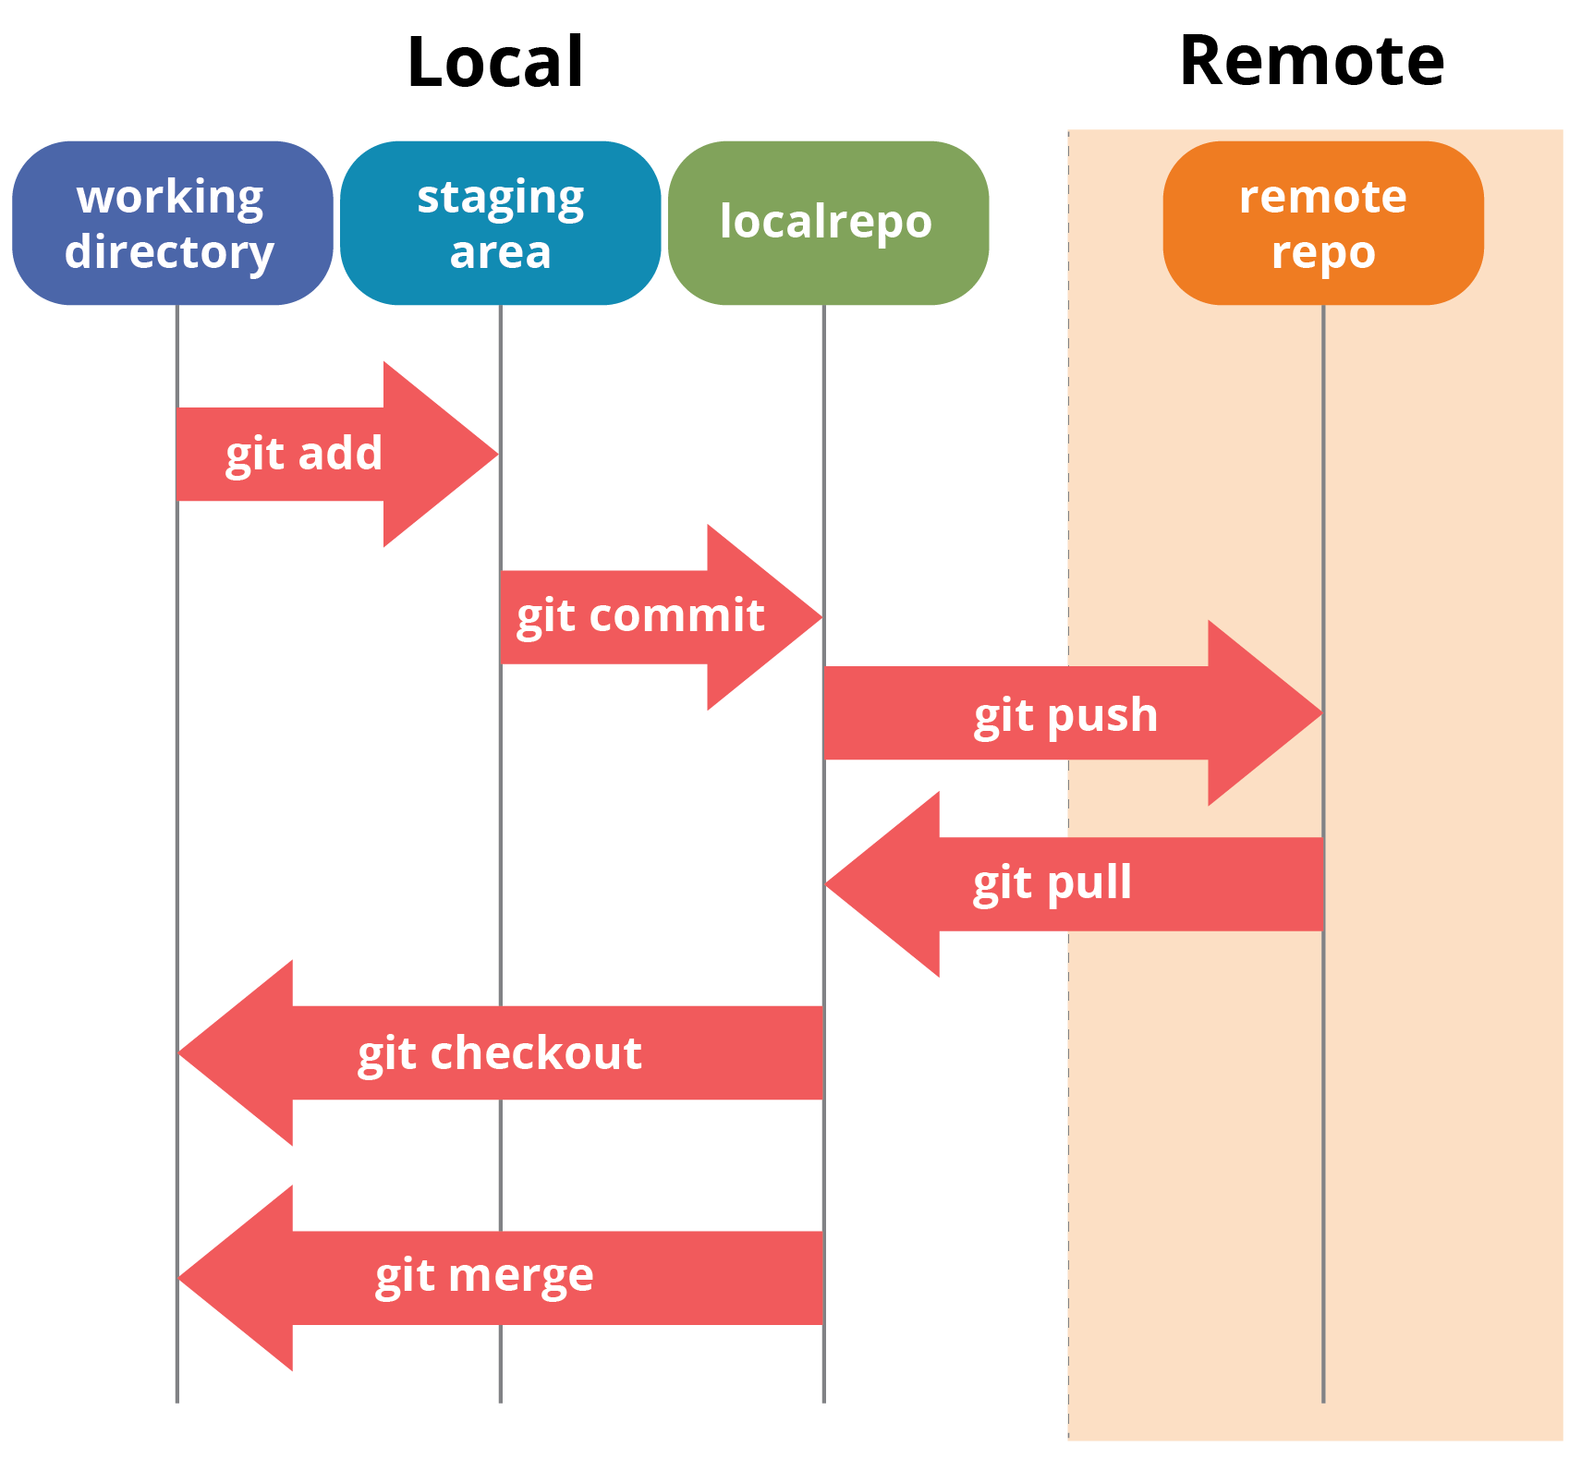
Git Basic Commands
+91 898-002-4735 (973) 598-3969 44 203-808-4216 +973 1619-8549
www.cognixia.com

Slide 29
.gitignore
Create a .gitignore file and add files and directories that you don't want to track
Does not work retro-actively
Can use git rm - - cached to only remove files from the staging area (after that, git will ignore the file)
note on windows: use git bash to touch .gitignore or rename the text file
+91 898-002-4735 (973) 598-3969 44 203-808-4216 +973 1619-8549
www.cognixia.com

Slide 30
Branches
git checkout (over-writes contents of working directory):
get specific version/commit of your project, replaces files in staging area
+91 898-002-4735 (973) 598-3969 44 203-808-4216 +973 1619-8549
www.cognixia.com

Slide 31
Branches
Branches are a reference to a specific commit
Each branch is a separate history of your project
Default branch is master
Can have multiple branches
Current branch tracks new commits
- branch points moves after each new commit
Pointers to all branches are located in .git/refs/heads
(remember branch is point to commit, and commit is wrapper around a tree)
Change branch with git checkout <branch>
+91 898-002-4735 (973) 598-3969 44 203-808-4216 +973 1619-8549
www.cognixia.com

Slide 32
Branches
Often a new branch will be started for each feature or modification that a developer is working on
Branches are completely independent from each other
+91 898-002-4735 (973) 598-3969 44 203-808-4216 +973 1619-8549
www.cognixia.com

Slide 33
Branches
Head: pointer to current snapshot of project
There is only ever one of them
Just tells you which branch is currently checked out
It is only locally significant, i.e. your current working snapshot does not need to be the same as someone else's (for example, when using GitHub)
+91 898-002-4735 (973) 598-3969 44 203-808-4216 +973 1619-8549
www.cognixia.com

Slide 34
Branches
You can make the head point to a specific branch or a specific commit with checkout
Git log
Head -> Master
Note: when you checkout a different point, git log will reflect this new position
- can change back to master with git checkout master
Commits made in headless state will be lost when you change the head back to a branch
+91 898-002-4735 (973) 598-3969 44 203-808-4216 +973 1619-8549
www.cognixia.com

Slide 35
Branches
Commands
Git branch: lists are local branches
Git branch <name>
Git checkout <name>
Git branch –d <name>
can only delete merged branches
Git branch –m <old> <new>
Common to create a new branch for each new feature
+91 898-002-4735 (973) 598-3969 44 203-808-4216 +973 1619-8549
www.cognixia.com

Slide 36
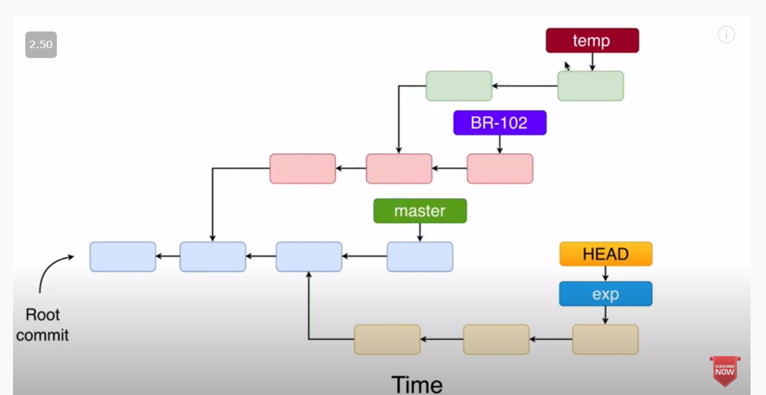
Branches
+91 898-002-4735 (973) 598-3969 44 203-808-4216 +973 1619-8549
www.cognixia.com

Slide 37
GitHub: Merging Branches
It's common to make a new branch for each feature
Fast-forward merge:
- "receiving branch" receives changes from incoming branches
- only works in the case of the next diagram
- it simply moves the pointers for the previous branch
+91 898-002-4735 (973) 598-3969 44 203-808-4216 +973 1619-8549
www.cognixia.com

Slide 38
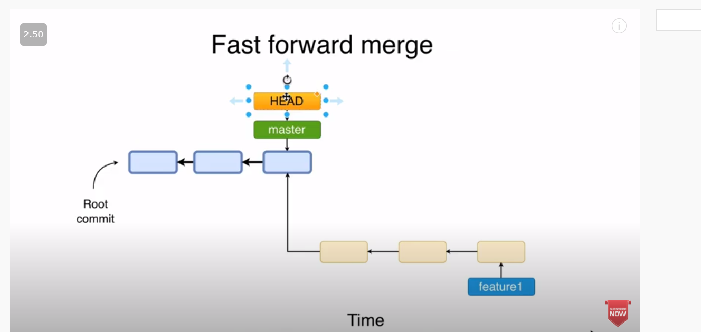
Github: Merging Branches
+91 898-002-4735 (973) 598-3969 44 203-808-4216 +973 1619-8549
www.cognixia.com

Slide 39
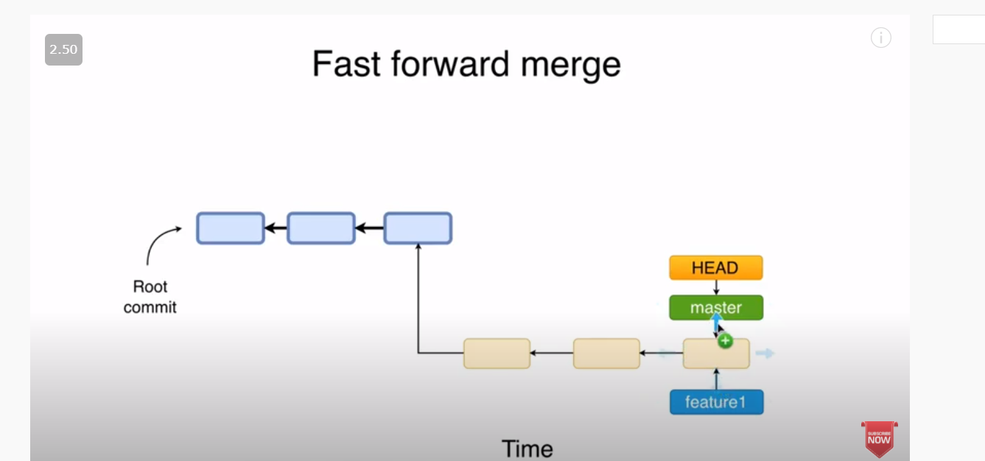
Github: Merging Branches
+91 898-002-4735 (973) 598-3969 44 203-808-4216 +973 1619-8549
www.cognixia.com

Slide 40
GitHub: Merging Branches
1. Make a new branch from the main/master branch
2. Make changes then commit them on the new branch
3. Checkout the main branch (receiving branch)
4. Merge feature branch to the current receiving branch
- git merge <feature-branch>
*generally safe to now delete merged branch
+91 898-002-4735 (973) 598-3969 44 203-808-4216 +973 1619-8549
www.cognixia.com

Slide 41
GitHub: Merging Branches
3-way merge
Git finds first nearest ancestor
Create a new commit
- this new commit will have two parents
- this way both branches histories are available
This new commit is called the "merge commit"
*reminder: whenever you change branches, git updates the content of the staging area*
Git cat-file <sha1> for merge commit to see both parents
+91 898-002-4735 (973) 598-3969 44 203-808-4216 +973 1619-8549
www.cognixia.com

Slide 42
Github: Merging Branches
There is an interesting tool called source tree that will allow you to see a graphical representation of the merges
Note that 3-way merge perserves the history of all branches!
+91 898-002-4735 (973) 598-3969 44 203-808-4216 +973 1619-8549
www.cognixia.com

Slide 43
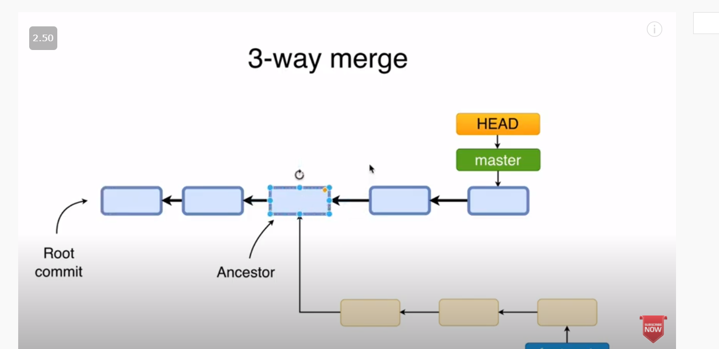
Github: Merging Branches
+91 898-002-4735 (973) 598-3969 44 203-808-4216 +973 1619-8549
www.cognixia.com

Slide 44
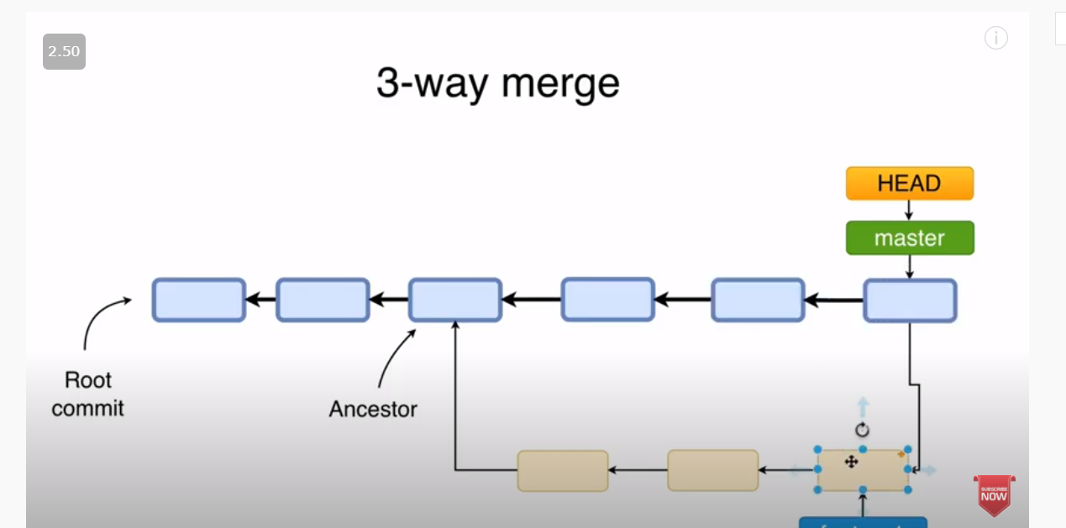
Github: Merging Branches
+91 898-002-4735 (973) 598-3969 44 203-808-4216 +973 1619-8549
www.cognixia.com

Slide 45
GitHub: Merging Conflicts
When two different changes are made to the same lines in two different branches, upon trying to merge the branches, you will receive a merge conflict
- not possible in fast-forward merge
When you try to merge, automatic merge will fail. The files will then be modified to show the merge conflicts.
You must update and commit these files
Check git status to see useful messages
- Can do git merge --abort
Git ls-files when there is a merge conflict to show files in the staging area. Can use git cat-file –p to see the different versions (check again after resolving conflict)
+91 898-002-4735 (973) 598-3969 44 203-808-4216 +973 1619-8549
www.cognixia.com

Slide 46
GitHub: Undoing and changing commits
git reset: destructive, removes part of history, can remove multiple commits
git revert: non-destructive, reverses a single commit and makes a new commit from this action
git ammend: destructive, used to update a commit if you make a typo. Destroys previous commit and creates a new one in it's place
+91 898-002-4735 (973) 598-3969 44 203-808-4216 +973 1619-8549
www.cognixia.com

Slide 47
Github
Github
Why is it called a "distributed version control system"?
Leads to Github...
Github: Repository Hosting Service
- can host the tracked repository (folder)
- if you delete it locally, will still be hosted online
- many people can download and share the same repository, work on the stored code as a team
+91 898-002-4735 (973) 598-3969 44 203-808-4216 +973 1619-8549
www.cognixia.com

Slide 48
Git Basic Commands
+91 898-002-4735 (973) 598-3969 44 203-808-4216 +973 1619-8549
www.cognixia.com

Slide 49
GitHub: Remote repositories
Remote repos are good for sharing your repo with others
You create the repo locally, then upload it to Github
- private vs public
Can also clone repositories from github locally, your own and other people's
- can restore work if you lose your computer
Github has a lot of features on top of git
- pull requests
- CI tools
Lab: Create github account
+91 898-002-4735 (973) 598-3969 44 203-808-4216 +973 1619-8549
www.cognixia.com

Slide 50
GitHub: Remote repositories
Repo names can only contain dashes
Note: the remote repo and local repo have the same structure
WD <-> SA <-> Git Repo
Lab: create repo.
Lab: modify readme.hd using web ui
Lab: commits from web ui
Lab: new branches from web ui
Lab: clone remote repo locally
+91 898-002-4735 (973) 598-3969 44 203-808-4216 +973 1619-8549
www.cognixia.com

Slide 51
GitHub: Remote repositories
Anyone can clone when public
Owner must give persmissions to update the repo
Note: important to have a center repo when working with many people,
i.e. sending a file is not practical
Note: when you clone a repo, git creates an automatic link between them.
It gives the remote repo a name, with the automatic one being origin
- advanced: can have a local repo connected to many remote repos,
and then you choose which repo you want to push or pull to
+91 898-002-4735 (973) 598-3969 44 203-808-4216 +973 1619-8549
www.cognixia.com

Slide 52
GitHub: Remote repositories
- git remote will show you all remote repos connected to your local repo
Note: when you clone, it will only make a copy of the master branch, it will not copy all branches from the remote repo (can list them all with git branch –a)
- you can then checkout a remote branch using git checkout
git remote show origin to see info about the origin branch
+91 898-002-4735 (973) 598-3969 44 203-808-4216 +973 1619-8549
www.cognixia.com

Slide 53
GitHub: Remote repositories
git push
- only push after testing and when you're sure things are working locally
git fetch (update git repository only)
Often used with git diff <local branch>..<origin/remote branch>
git pull (update working directory, SA and git repo, i.e. fetch+merge)
- remote branch is merged into currently checkout branch
Git will first upload local changes for comparison, then download remote changes
Lab: create a remote branch in the github UI, then check to see if the branch exists locally. Then use git fetch to update list.
+91 898-002-4735 (973) 598-3969 44 203-808-4216 +973 1619-8549
www.cognixia.com

Slide 54
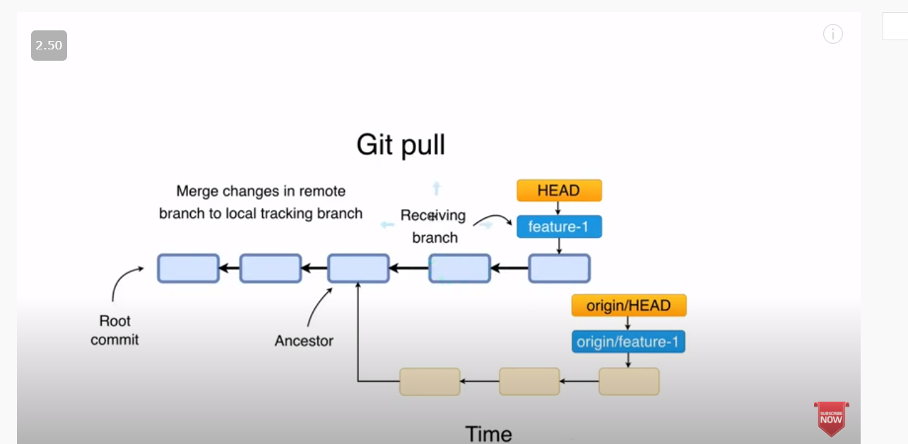
GitHub: Remote repositories
+91 898-002-4735 (973) 598-3969 44 203-808-4216 +973 1619-8549
www.cognixia.com

Slide 55
GitHub: Remote repositories
Lab: create a change in both local and remote repos to force a merge conflict
Resolve the conflict
Hint: pull and resolve the conflict locally then push the changes to the remote repo
+91 898-002-4735 (973) 598-3969 44 203-808-4216 +973 1619-8549
www.cognixia.com

Slide 56
GitHub: Remote repositories
Create branch locally and push to remote
git push --set-upstream origin <branch name>
git push origin --delete <branch name>
+91 898-002-4735 (973) 598-3969 44 203-808-4216 +973 1619-8549
www.cognixia.com

Slide 57
GitHub: Pull Request
Pull request:
Sounds like it should be called push request but...
You are asking the owner of another repository to pull code from your repository into their repository.
+91 898-002-4735 (973) 598-3969 44 203-808-4216 +973 1619-8549
www.cognixia.com

Slide 58
GitHub: Pull Request
Important for working with others when you don't have admin permissions on the remote repo
- Pull request is asking the repo owner/admin to pull your code into their repo (good for open source)
- can also use this to get feedback on your code
First fork the repo
Make changes and commit
Login into GitHub and ask to start and pull request
(can also do this from command line)
+91 898-002-4735 (973) 598-3969 44 203-808-4216 +973 1619-8549
www.cognixia.com

Slide 59
GitHub: Workflow
Get some coding requirements, a module
git pull to make sure you have the most recent version
Make a branch (copy of all code in master) - give a good branch name
Code in module
Commit code
---check if code has changed (next slide)---
+91 898-002-4735 (973) 598-3969 44 203-808-4216 +973 1619-8549
www.cognixia.com

Slide 60
GitHub: Workflow
Update the fork:
# Add 'upstream' repo to list of remotes
git remote add upstream https://github.com/UPSTREAM-USER/ORIGINAL-PROJECT.git
# Verify the new remote named 'upstream'
git remote –v
# Fetch from upstream remote
git fetch upstream
# View all branches, including those from upstream
git branch –va
# Checkout your master branch and merge upstream
git checkout master
git merge upstream/master
+91 898-002-4735 (973) 598-3969 44 203-808-4216 +973 1619-8549
www.cognixia.com

Slide 61
GitHub: Workflow
git pull: see if there was merge conflicts
---merge new changes into your branch
git checkout <your branch>
git merge master: bring the changes in master into your new branch
-> will have to resolve merge conflict (sometimes you will want to collaborate on this)
-> you can check the master branch on Github to see what they did since you downloaded the code
-> should communicate with whoever is working on the code
Now you can create a pull request
+91 898-002-4735 (973) 598-3969 44 203-808-4216 +973 1619-8549
www.cognixia.com

Slide 62
GitHub: Workflow
Pull request
Have a back-and-forth dialogue with someone you're working:
comment on their code
have them make changes and recommit
accept the pull request
Check for emails
Check that the master on the main shared repo has been accepted
+91 898-002-4735 (973) 598-3969 44 203-808-4216 +973 1619-8549
www.cognixia.com

Slide 63
GitHub: Workflow
Advice: merge from public branches (dev, master, etc.) into your private branches often. If you don't do this for a while, you can end up with many merge conflicts, which you will have to resolve simultaneously.
Advanced commands:
Merge and squashing
Rebase (do not rebase commits outside your own repo)
+91 898-002-4735 (973) 598-3969 44 203-808-4216 +973 1619-8549
www.cognixia.com

Slide 64


